Slide 1
ENGI 301 QuadCopter PB Cape Proposal
19th November, 2018
Walker Grimes

Slide 2
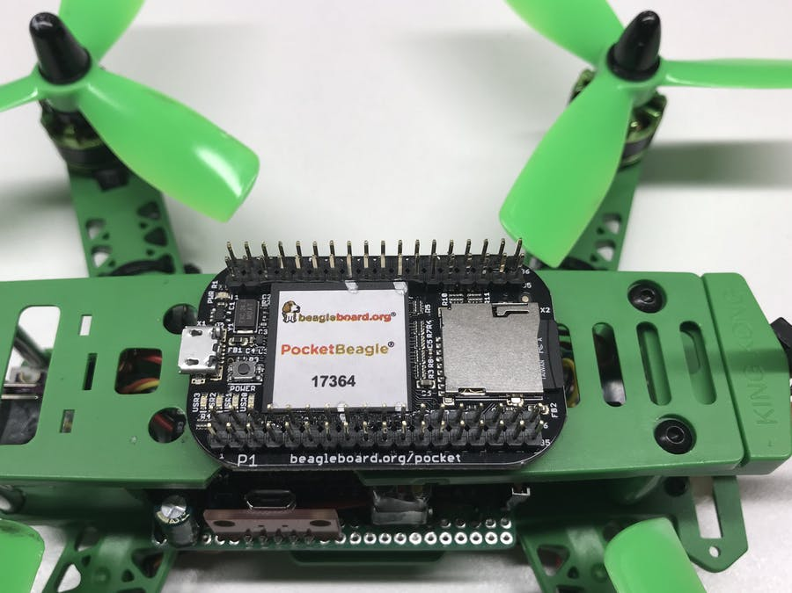
Background Information
I have already implemented the PB with Drone motors.
The PB lacks several critical systems that standard flight control boards have
Accelerometer
Gyroscope
Barometer
Altimeter
GPS
The goal of this project is to design a cape for the PB to meet these needs
https://www.hackster.io/patrickpoirier51/pocketpilot-an-autopilot-based-on-the-25-pocketbeagle-1fa14b
Fig 1: Pocket Pilot

Slide 3
Board Functionality
This board will serve two purposes:
The PB doesn’t have the required instrumentation for proper flight control. This board will incorporate the three major chips (GPS, Accel/Gyro, Altimeter)
The PB PWM pins are far apart and connecting the motors required a homemade breakout board. The cape will have a cluster of pins to simplify connections

Slide 4
Functional Block Diagram
(GND,Vin,GND)
Motor Power Out
PDB
PocketBeagle
100 mil 3 prong male headers
(GND,nc,sig)
1300mah,14v, 4s LiPo Dynogy Battery
5V BEC
Vin
Accel/Gyro
MPU6050
1.8V
Level
Shifter
3.3V
I2C
M1
Altimeter
3.3V
M2
I2C
PWM
M3
GPS
6 Pin JST-SH (UART)
M4
Micro USB
USB1 Port (P1_5,7,9,11,13,15)
BR2205 Motors

Slide 5
Mechanical Diagram
PocketBeagle
Cape
The cape will go on top of the PB
The connection will be accomplished by two 36 pin male headers on the bottom of the board matching the female headers on the board
Same Size
2.21”
1.38”

